Slide 1
Iodine sales forecast for Chinese market

Slide 2
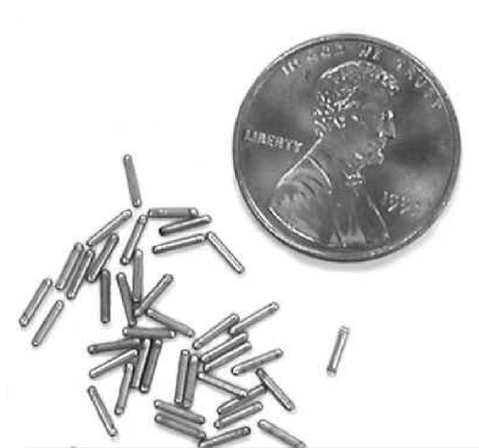
I-125 radioisotope for cancer therapy

Slide 3
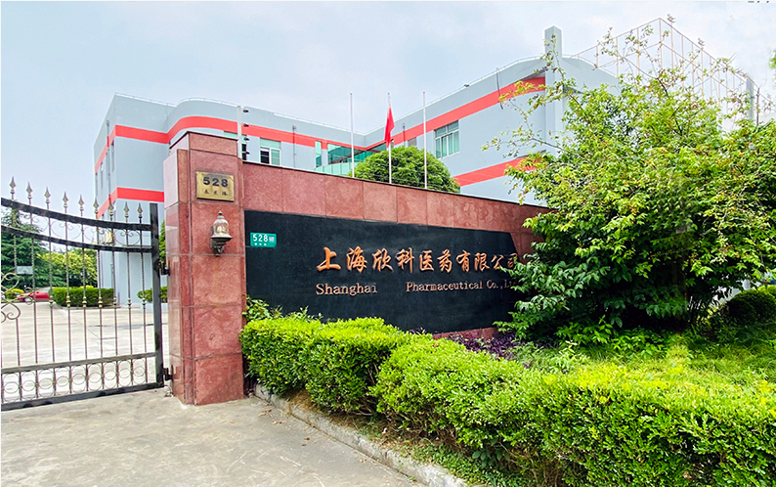
China market: fast growth, no transparency

Slide 4
One client example: sales trends

Slide 5
ETL: the biggest headache

Slide 6
Looking forward: web-based forecast portal

